Slide 1
Applications and Future Directions of Generative Adversarial Networks
Chengjia Wang
2019 April 24, IIAT-HZ

Slide 2
Applications and Future Directions of GANs
High Resolution Image Synthesis
Text-based Image Synthesis
3D Data Synthesis
Adversarial Domain Adaptation
Discussion

Slide 3
High Resolution Image Synthesis

Slide 4
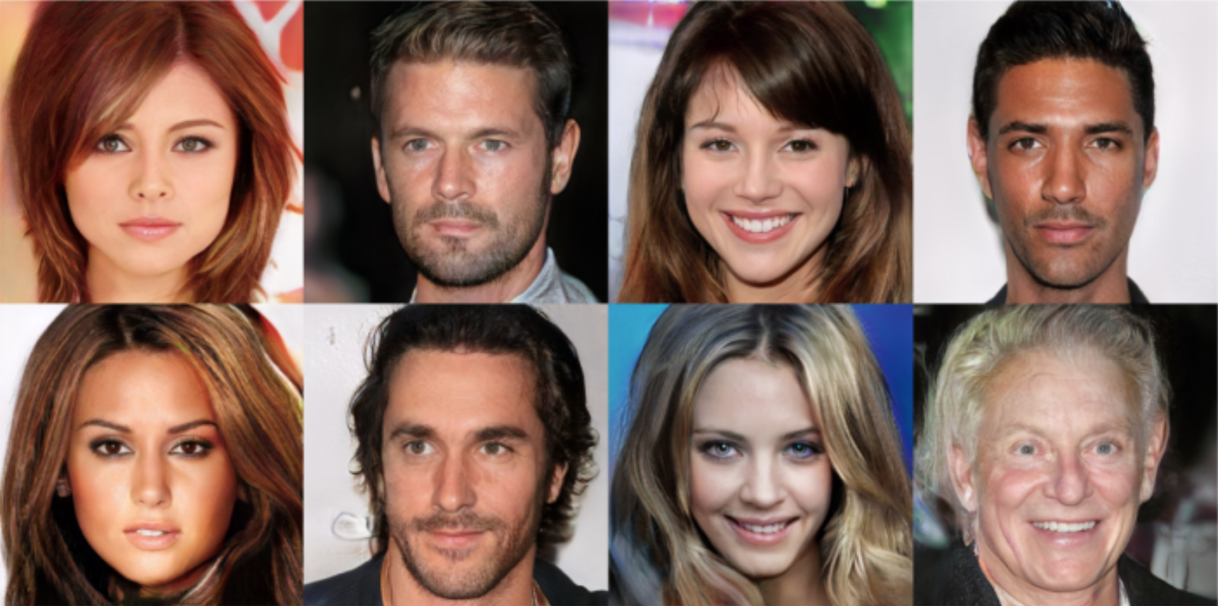
High Resolution Image Synthesis
Progressive GAN
Progressive Growing of GANs for Improved Quality, Stability, and Variation. T. Karras, T. Aila, et al. ICLR. 2018.
Notes:
时间现在来到2018年
https://zhuanlan.zhihu.com/p/60432882

Slide 5
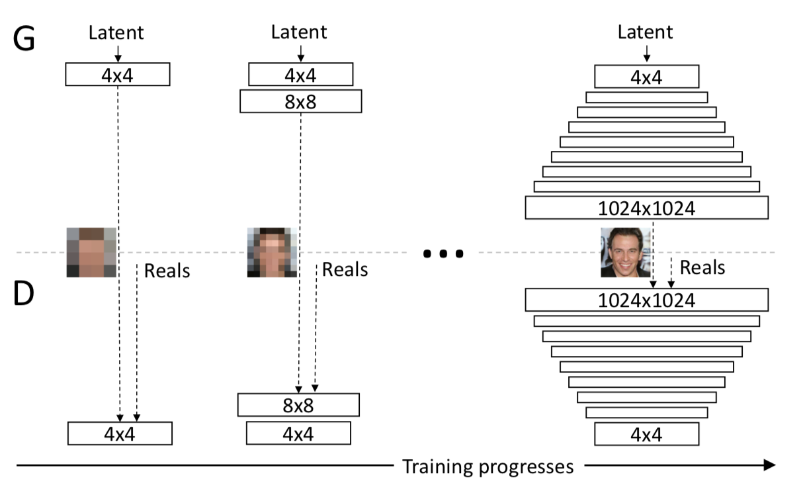
High Resolution Image Synthesis
Progressive GAN
Progressive Growing of GANs for Improved Quality, Stability, and Variation. T. Karras, T. Aila, et al. ICLR. 2018.
Notes:
https://zhuanlan.zhihu.com/p/60432882

Slide 6
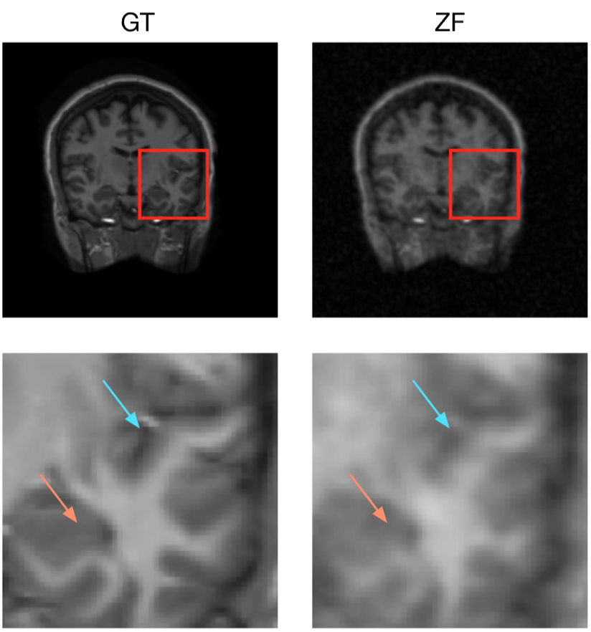
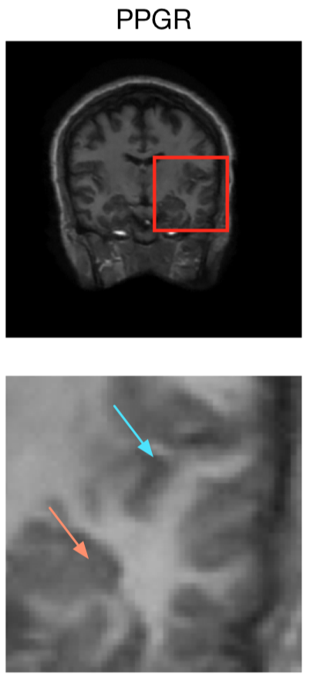
High Resolution Image Synthesis
Utilising Feature Information for Medical Image Reconstruction
E
G
X_{L}
$\hat{X}$_{H}
D
real
fake
L2
L2
E
X_{H}
Pre-trained CNN
Deep De-Aliasing for Fast Compressive Sensing MRI. S. Yu, H. Dong, G. Yang et al. arXiv:1705.07137 2017.
DAGAN: Deep De-Aliasing Generative Adversarial Networks for Fast Compressed Sensing MRI Reconstruction.
G. Yang, S. Yu, H. Dong et al. TMI 2017.
Notes:
G只生成缺失的部分，防止胡乱生成

Slide 7
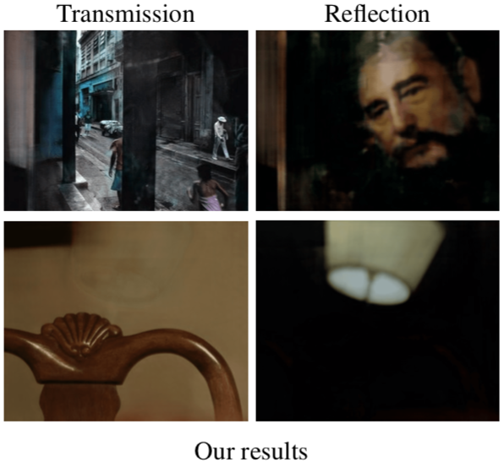
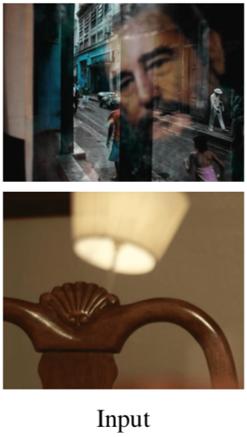
High Resolution Image Synthesis
Image Reflection Separation
Single Image Reflection Separation with Perceptual Losses. X. Zhang, R. Ng, Q. Chen. CVPR. 2018.
Notes:
G只生成缺失的部分，防止胡乱生成

Slide 8
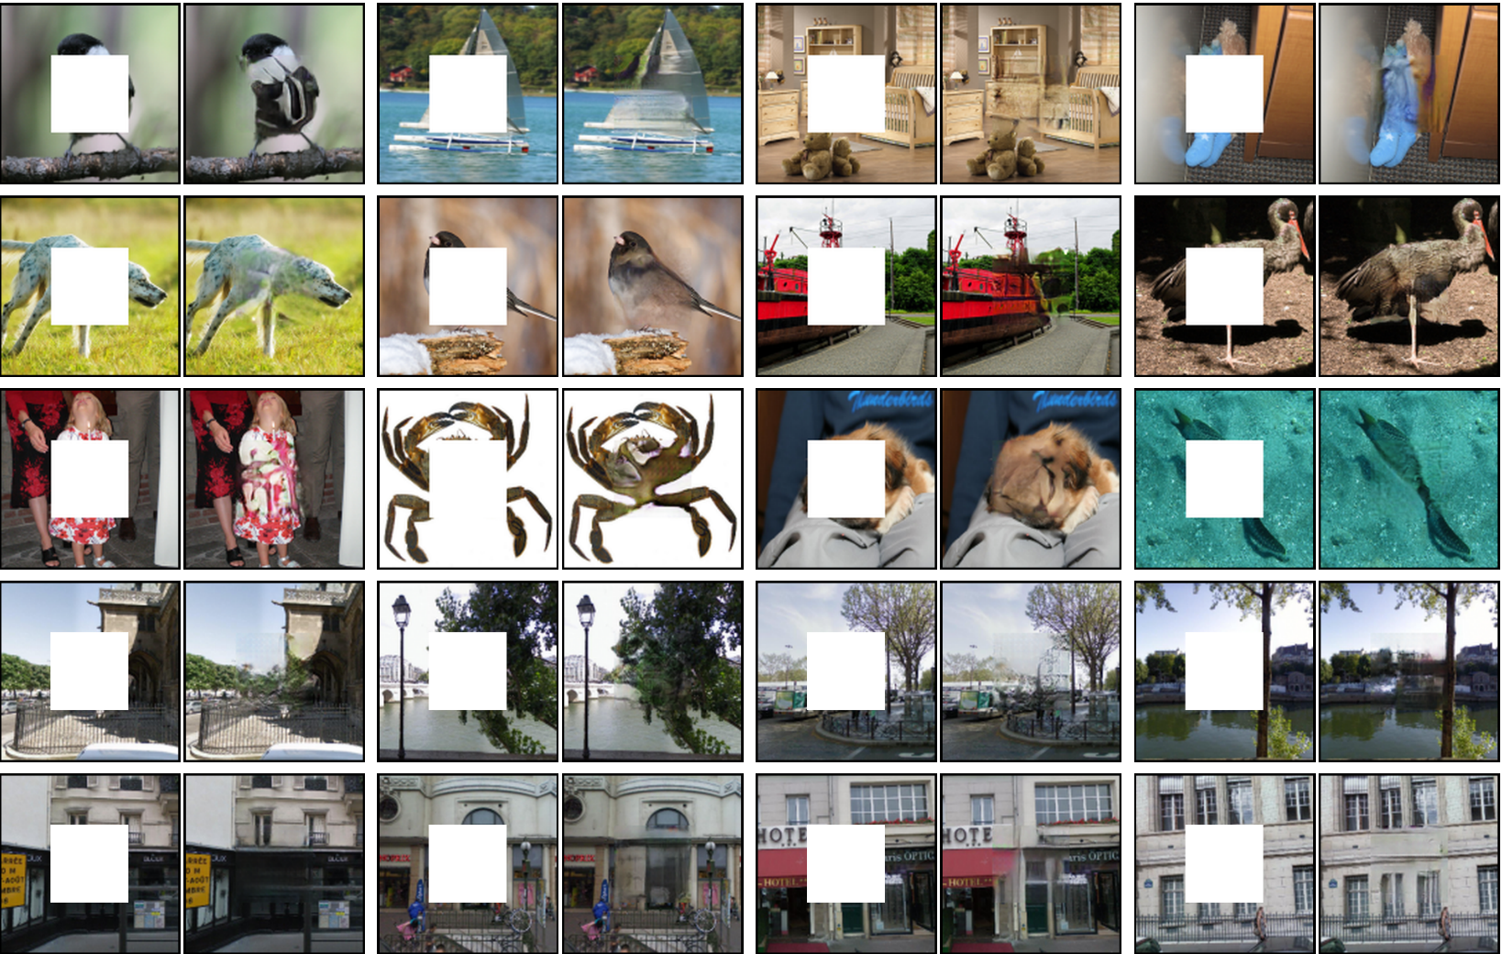
High Resolution Image Synthesis
Image inpainting
Context Encoders: Feature Learning by Inpainting. D. Pathak, J. Donahue. CVPR. 2017
Notes:
G只生成缺失的部分，防止胡乱生成

Slide 9
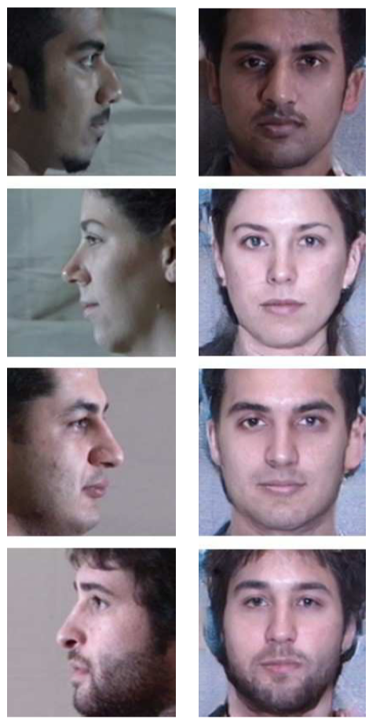
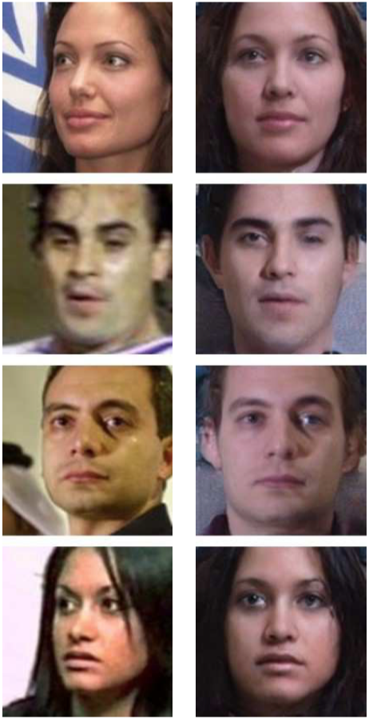
High Resolution Image Synthesis
Face Rotation
Input Output
Input Output
Pose-Guided Photorealistic Face Rotation. Y. Hu, X. Wu et al. CVPR. 2018
Notes:
G只生成缺失的部分，防止胡乱生成

Slide 10
Text-based Image Synthesis

Slide 11
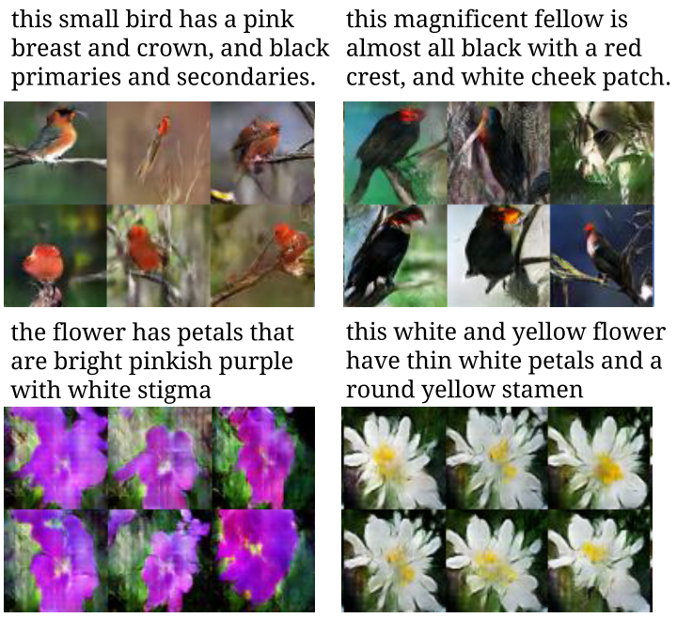
Text-based Image Synthesis
Text-to-image synthesis
Multi-modal problem
P(t, z)
Generative Adversarial Text to Image Synthesis. S. Reed, Z. Akata et al. ICML. 2016.
Notes:
一个很形象的例子是，我说这是一个帅哥，

Slide 12
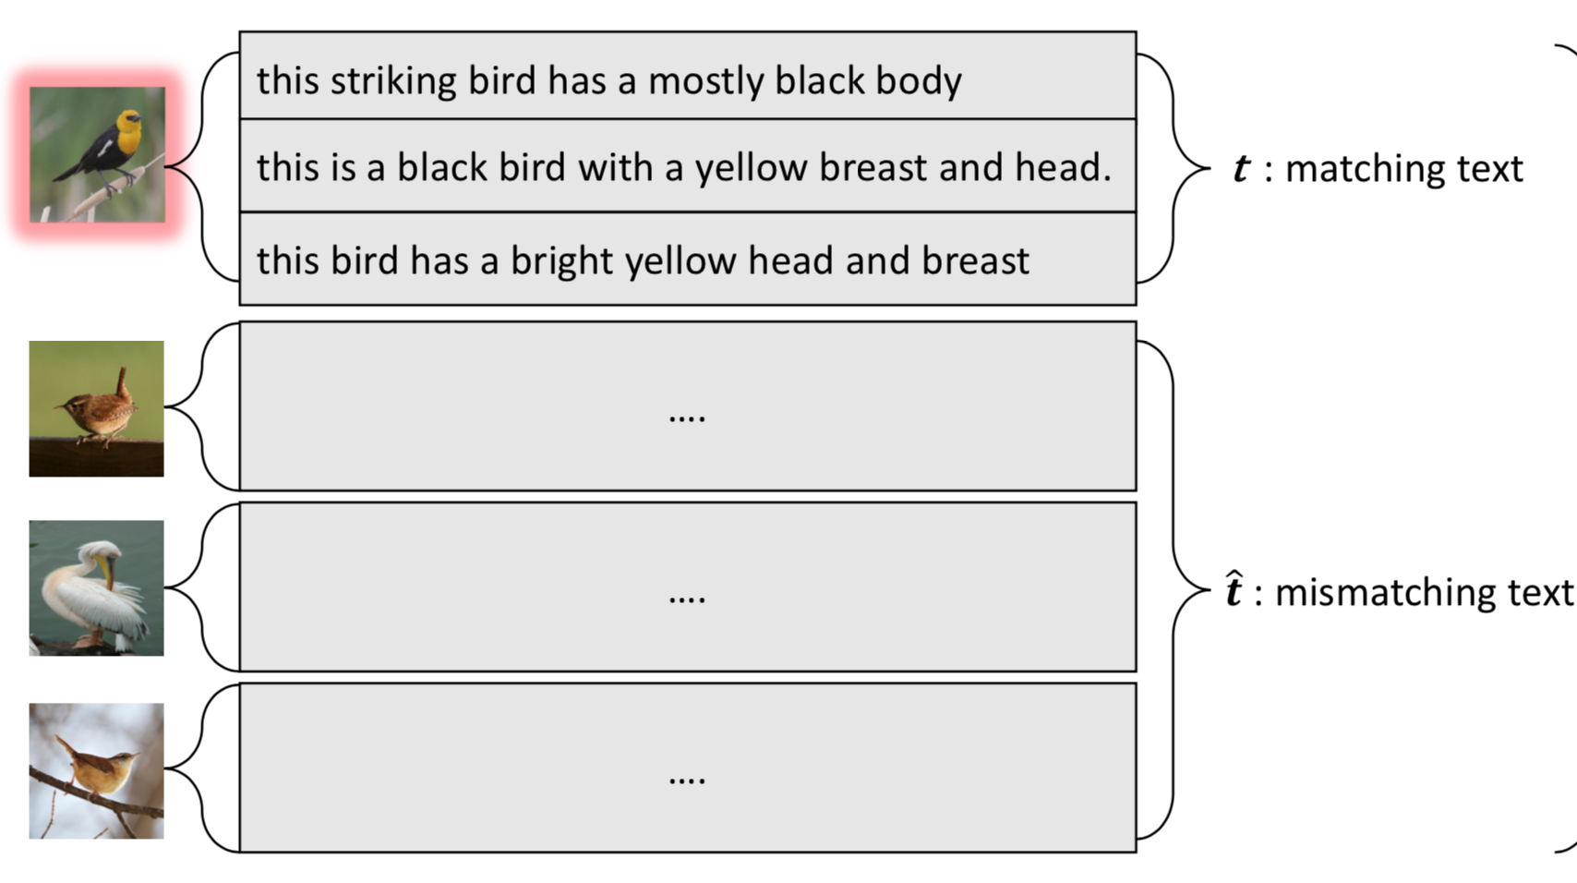
Text-based Image Synthesis
Text-to-image synthesis
匹配的句子
不匹配的句子
Generative Adversarial Text to Image Synthesis. S. Reed, Z. Akata et al. ICML. 2016.

Slide 13
Text-based Image Synthesis
Text-to-image synthesis
t
$φ$RNN Encoder
$φ$RNN Encoder
$\hat{t}$
t : matching text
$\hat{t}$: mismatched text
Z
G
$$\hat{\text{X} }$$
D
real
fake
X
Learn to fool discriminator
1. Learn to classify matching image and text as real sample
2. Learn to classify mismatched image and text as fake sample
3. Learn to classify image from generator as fake sample

Slide 14
Text-based Image Synthesis
Text-to-image synthesis + High resolution image
t
t
$φ$RNN Encoder
$φ$RNN Encoder
$φ$RNN Encoder
$φ$RNN Encoder
$\hat{t}$
$\hat{t}$
G1
D1
real
G2
D2
real
Z
$$\hat{\text{X} }$$
Z
G1
$$\hat{\text{X} }$$
fake
fake
X
X
Step 1
Step 2
StackGAN: Text to Photo-realistic Image Synthesis with Stacked Generative Adversarial Networks. H. Zhang, T. Xu et al. ICCV. 2017.

Slide 15
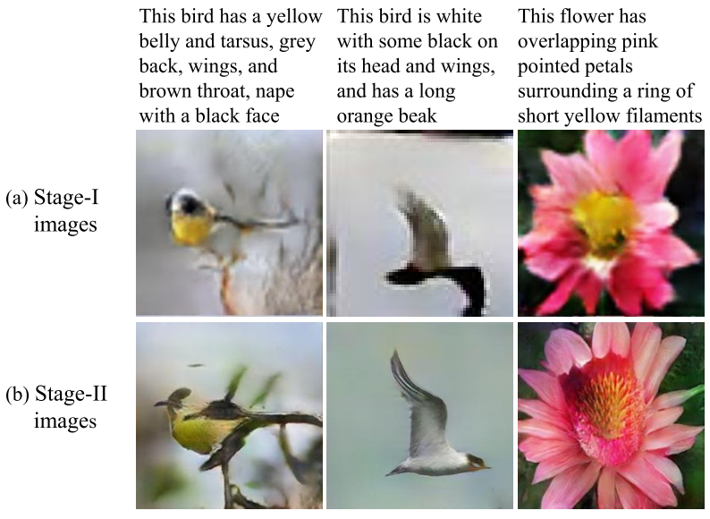
Text-based Image Synthesis
Text-to-image synthesis + High resolution image
StackGAN: Text to Photo-realistic Image Synthesis with Stacked Generative Adversarial Networks. H. Zhang, T. Xu et al. ICCV. 2017.

Slide 16
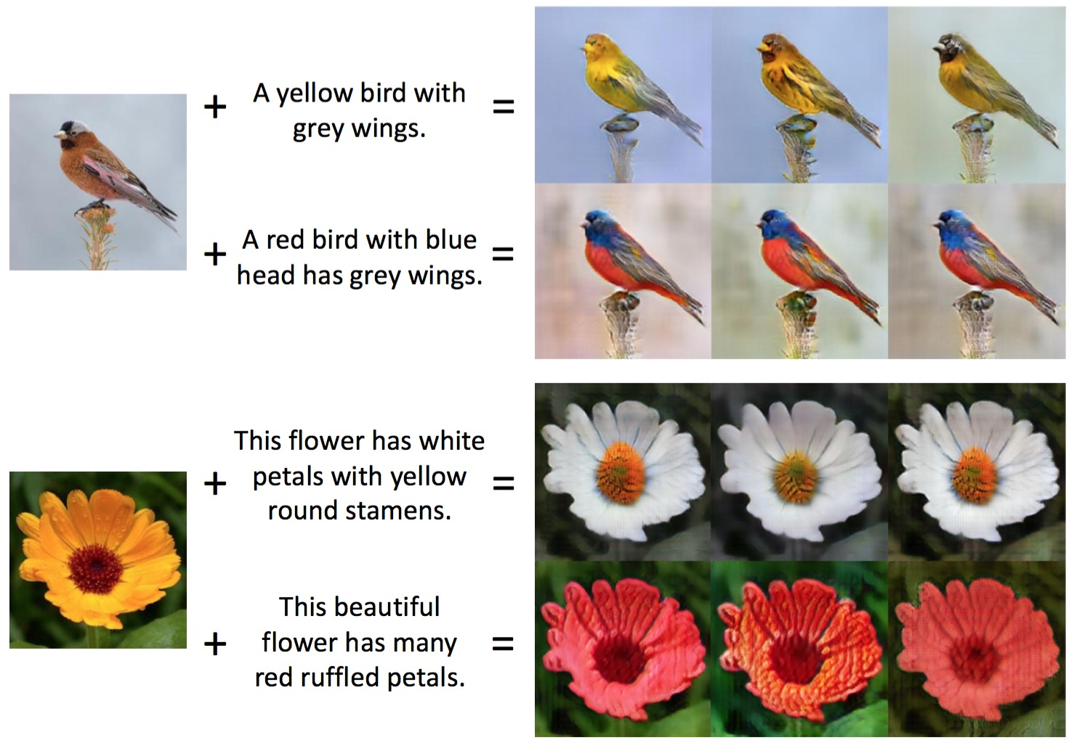
Text-based Image Synthesis
Semantic image synthesis
Semantic Image Synthesis via Adversarial Learning. H. Dong, S. Yu et al. ICCV 2017.

Slide 17
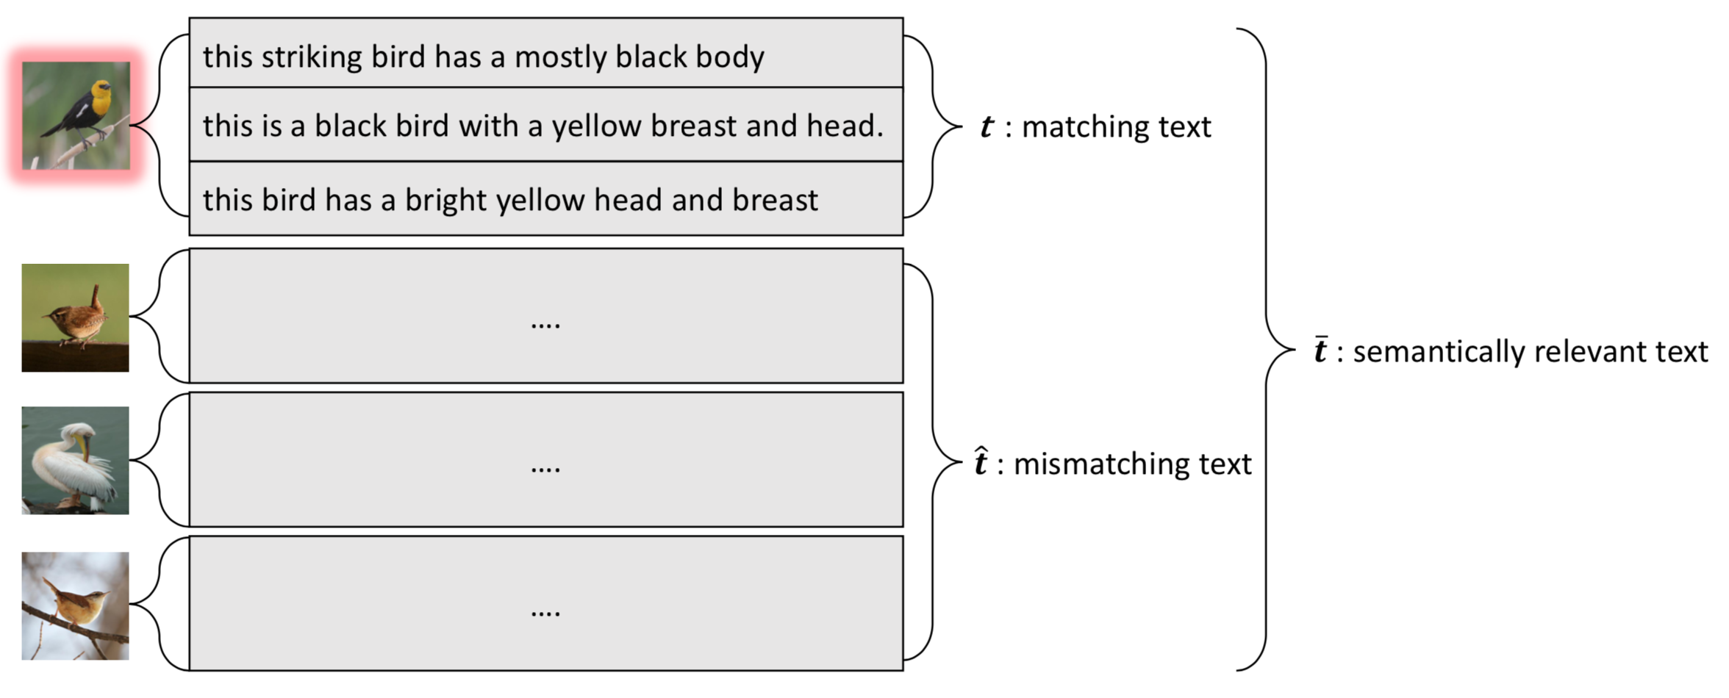
Text-based Image Synthesis
Semantic image synthesis
匹配的句子
相关的句子
不匹配的句子
Semantic Image Synthesis via Adversarial Learning. H. Dong, S. Yu et al. ICCV 2017.

Slide 18
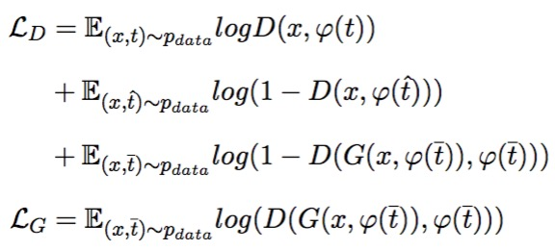
Text-based Image Synthesis
Semantic image synthesis
t : matching text
$$\overline{t}$$
$\hat{t}$: mismatched text
$φ$ RNN Encoder
t
$φ$ RNN Encoder
$\overline{t}$ : semantically relevant text
$\hat{t}$
E
Residual
G
D
real
X
$$\hat{\text{X} }$$
fake
X
Learn to fool discriminator when inputting image with semantically relevant text
1. Learn to classify matching image and text pairs as real samples
2. Learn to classify mismatched image and text pairs as fake samples
3. Learn to classify samples from generator as fake samples
Semantic Image Synthesis via Adversarial Learning. H. Dong, S. Yu et al. ICCV 2017.

Slide 19
3D Data Synthesis

Slide 20
3D Data Synthesis
3D-GAN
Learning a Probabilistic Latent Space of Object Shapes via 3D Generative-Adversarial Modeling.
J. Wu, C. Zhang et al. NIPS. 2016.
Notes:
G只生成缺失的部分，防止胡乱生成

Slide 21
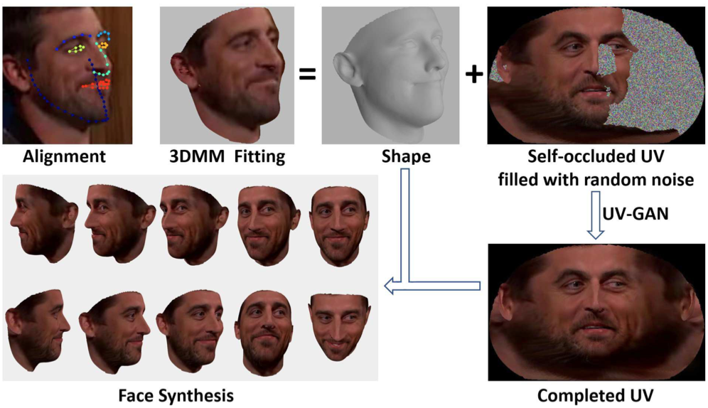
3D Data Synthesis
UV-GAN
UV-GAN: Adversarial Facial UV Map Completion for Pose-invariant Face Recognition.
J. Deng, S. Cheng et al. CVPR. 2018.
Notes:
G只生成缺失的部分，防止胡乱生成

Slide 22
Adversarial Domain Adaptation

Slide 23
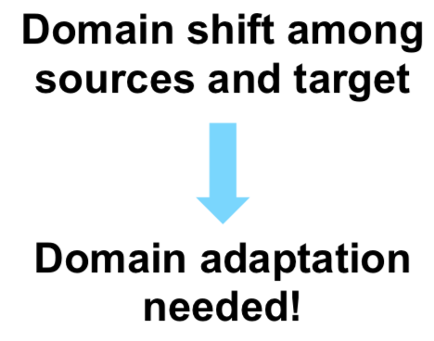
Adversarial Domain Adaptation
Single Source Domain Adaptation
Source: Labelled
Target: Unlabelled
Domain-Adversarial Training of Neural Networks. Y. Ganin, H. Ajakan et al. JMLR. 2016

Slide 24
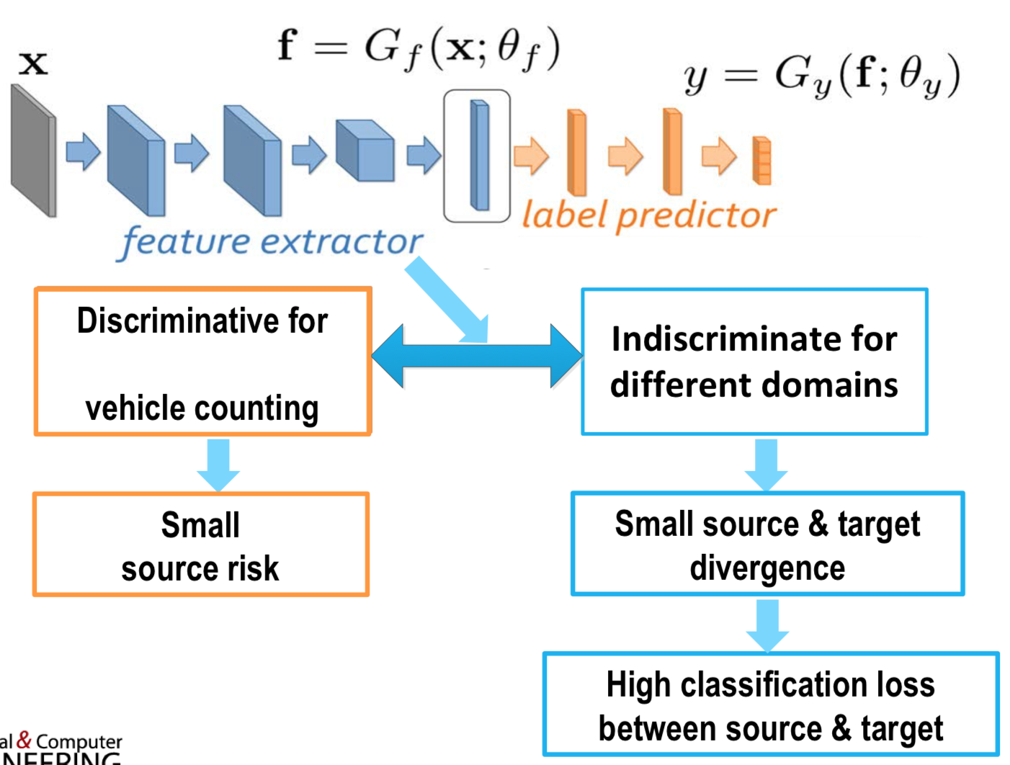
Adversarial Domain Adaptation
Learn domain-universal & task-discriminative features
Domain-Adversarial Training of Neural Networks. Y. Ganin, H. Ajakan et al. JMLR. 2016

Slide 25
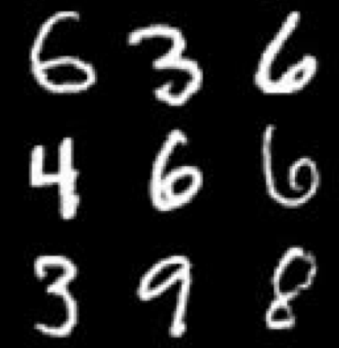
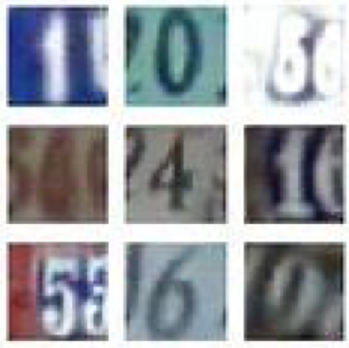
Adversarial Domain Adaptation
Single Source Domain Adaptation
XS
E
Task
learner
result
XT
D
Source
Target
Source images have label
Target images do not have label
Domain-Adversarial Training of Neural Networks. Y. Ganin, H. Ajakan et al. JMLR. 2016

Slide 26
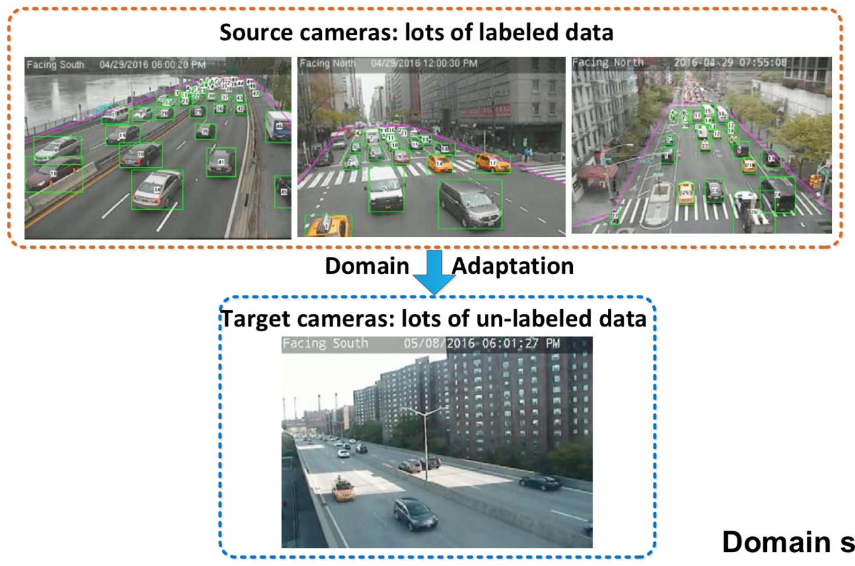
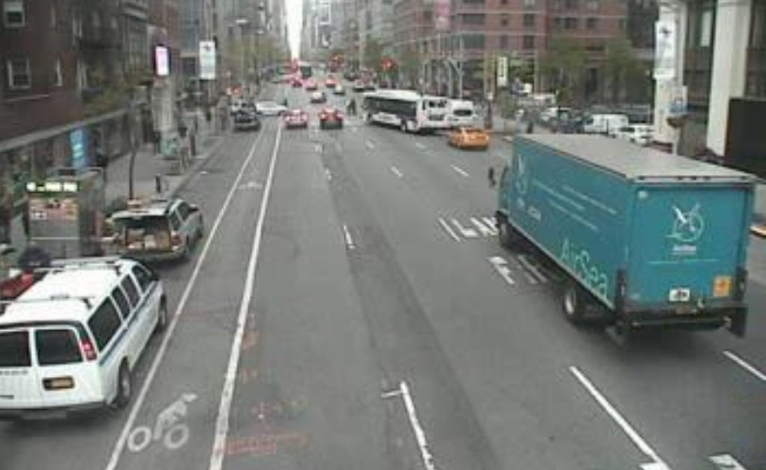
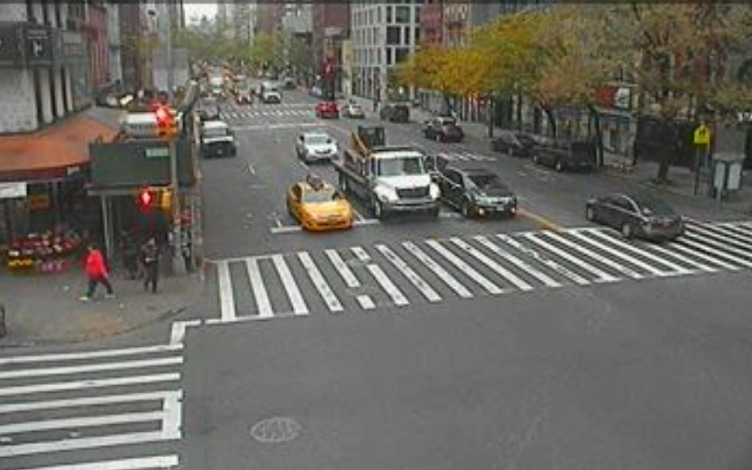
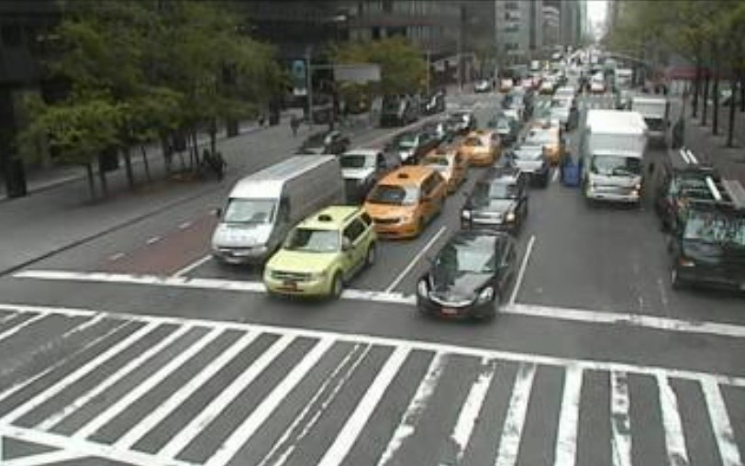
Adversarial Domain Adaptation
Multiple Source Domain Adaptation
Local devices
Internet
Cloud
$x$_{s1}
Source 1
$$F(x)$$
Task
$$xs2$$
Source 2
$$Ds1$$
Discriminator 1
Source images have label
Target images do not have label
……..
$$Ds2$$
Discriminator 2
$$xsk$$
$$Dsk$$
Source k
Discriminator k
$$xt$$
Target
Multiple Source Domain Adaptation with Adversarial Learning. S. Zhang, H. Zhao et al. NIPS. 2018.

Slide 27
Adversarial Domain Adaptation
Multiple Source Domain Adaptation
XS1
…
E
Task
learner
Local devices
Internet
Cloud
XSk
result
$x$_{s1}
Source 1
$$F(x)$$
XT
Task
Source1
$$xs2$$
D1
$$Ds1$$
Target
Source 2
Discriminator 1
…
……..
$$Ds2$$
Discriminator 2
Dk
Sourcek
$$xsk$$
Target
$$Dsk$$
Source k
Discriminator k
Source images have label
Target images do not have label
$$xt$$
Target
Multiple Source Domain Adaptation with Adversarial Learning. S. Zhang, H. Zhao et al. NIPS. 2018.

Slide 28
Discussion

Slide 29
Discussion
Q1. 除了以上的应用之外，还能不能想到其他问题可用GAN或对抗训练来解决的？
Q2. 除了把text和image做融合，还有其他任务是两个不同模态的数据融合的吗？
Q3. 现在的GAN存在什么问题？

Slide 30
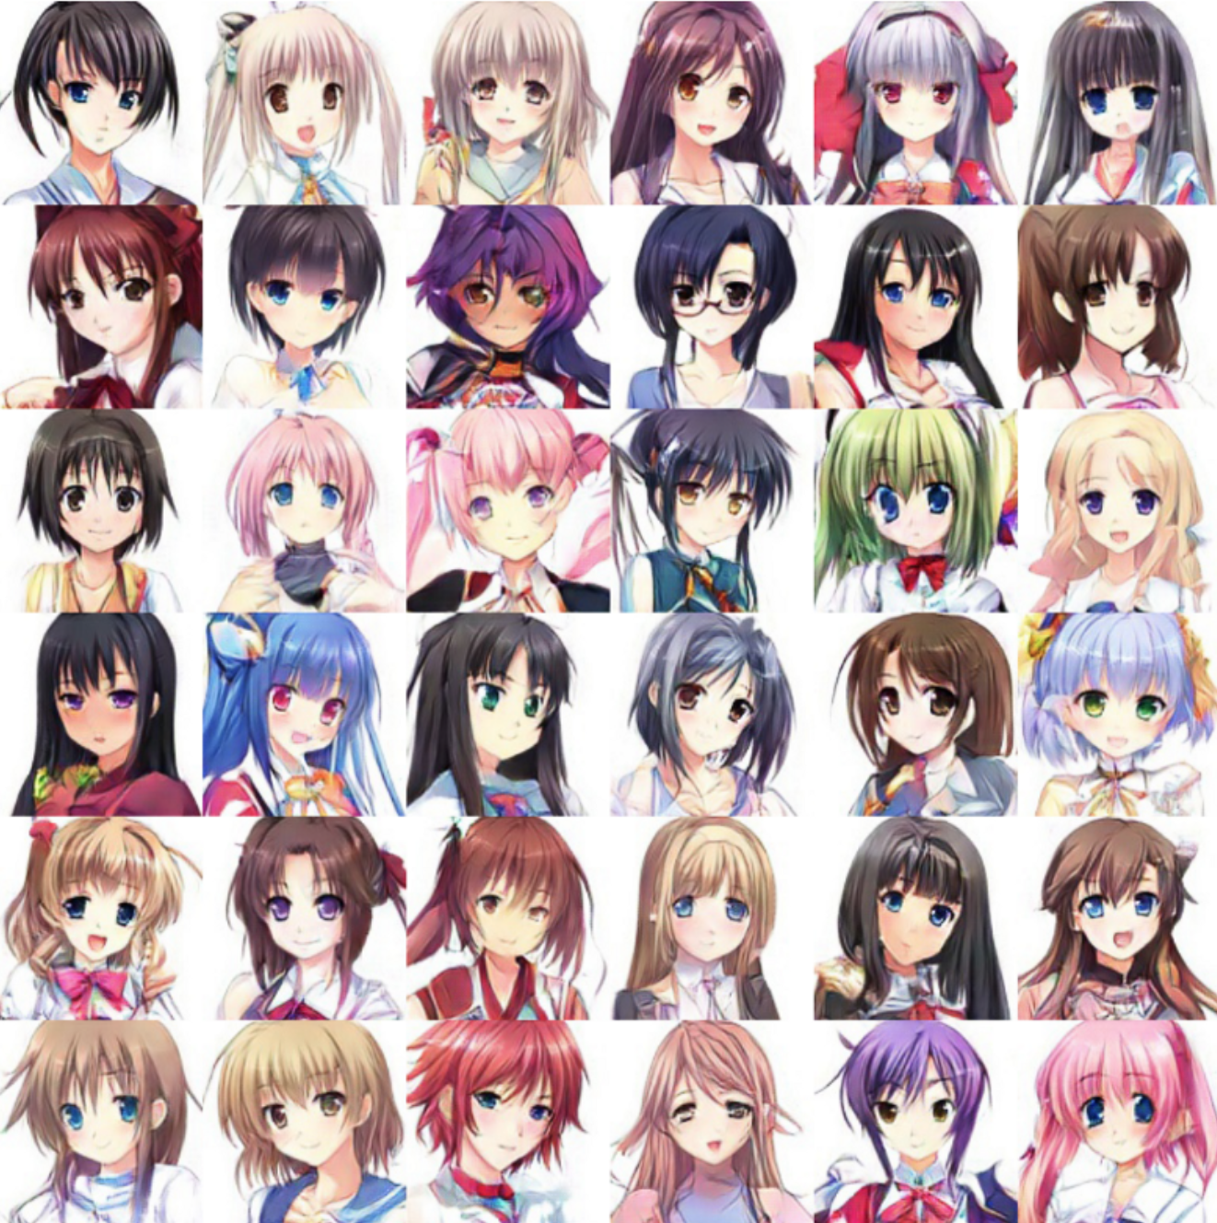
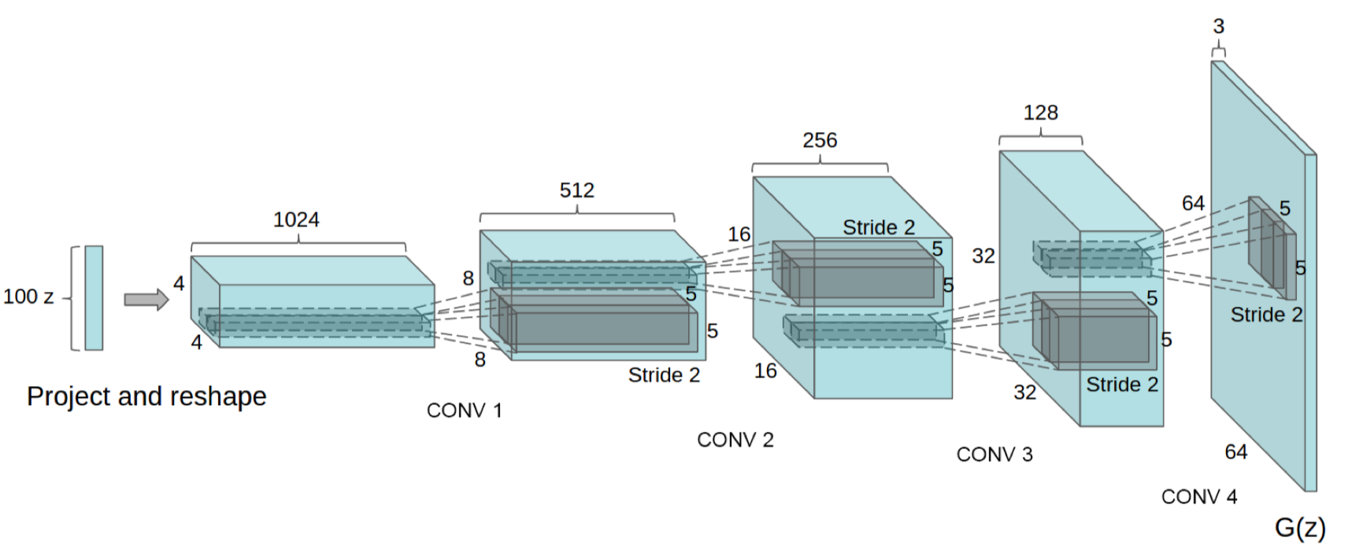
Thank You

